Slide 1
Lending Club Dataset
2013-2018
Period:
$
XXXXXXXXX
DOLLARS
Lending Club is the world’s largest online credit marketplace for peer to peer lending, facilitating personal loans, business loans, and financing for elective medical procedures.
Group 3
Presented By

Slide 2
Group 3
Introduction
Batch Details | PGPDSE-FT Gurgaon OCT22
Team Leader | Akshay Kumar
Team Members | Akshay Kumar Prabhat Mishra Deepanshu Khera Gunjan Rana Akanksha Marwah Sahil
Mentor Name | Ms Anjana Agrawal
Proposed Project Title | Lending Club Loan Defaulters Prediction
Domain of Project | Loan Default Prediction

Slide 3
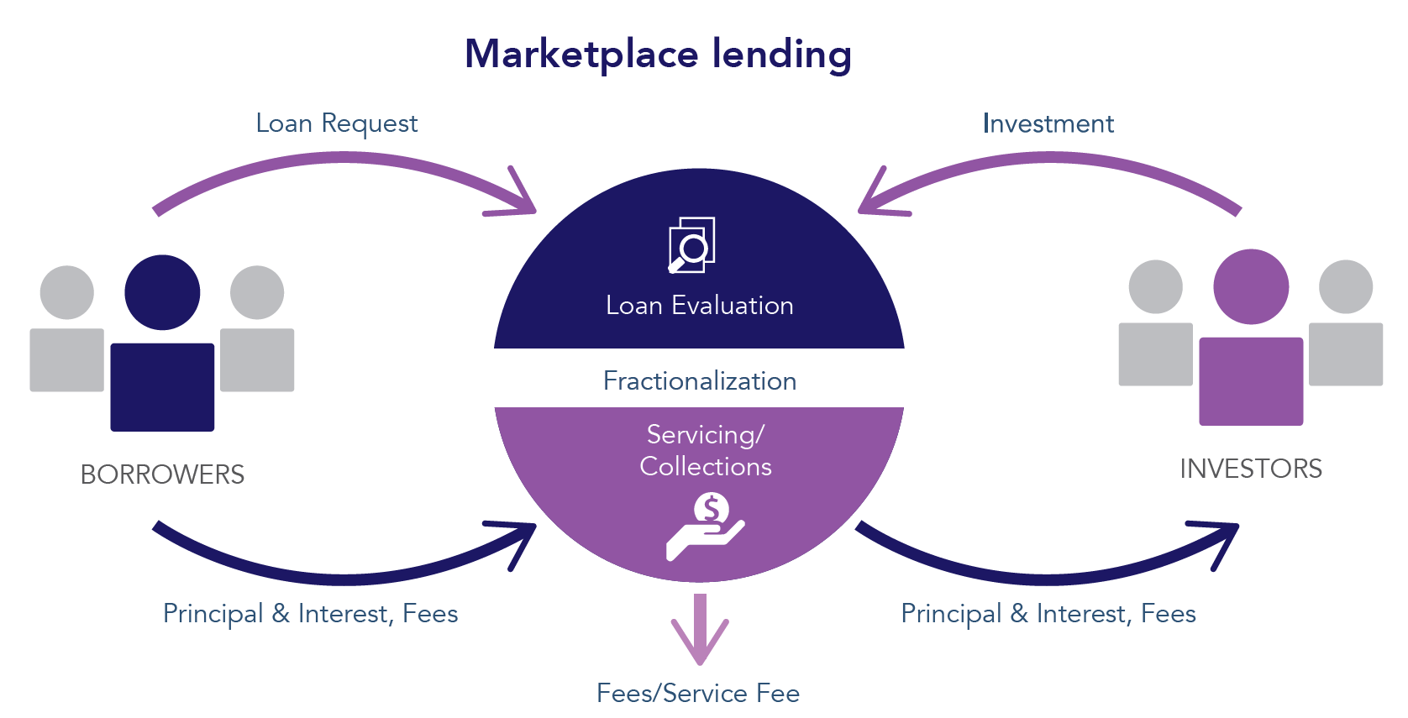
About Dataset

Slide 4
01
Problem Statement
2013-2018
Period:
$
XXXXXXXXX
DOLLARS
To classify if the borrower will default on the loan using the borrower's finance history. That means, given a set of new predictor variables, we need to predict the target variable (‘loan_status’) as
Charged Off
Fully Paid
1
0

Slide 5
Phase -1 EDA with Base Model
Period:
2013-2018
$
XXXXXXXXX
DOLLARS
Group 3
Presented By

Slide 6
02
Exploratory Data Analysis
Phase
01
Phase
02
Phase
03
Phase
04
Phase
05
Univariate followed by
Bivariate Analysis
Data Pre- Processing
(Scaling & Encoding)
Column Selection
Treating
Missing Values
Statistical Analysis

Slide 7
Column Selection
P
H
A
S
E
1
01
We have selected only the individual applicants, so we have removed all the columns related to\ belong to joint borrowers.
02
We removed all the columns with unique values, such as member id, url, id, description, etc.
03
We removed the data with more than 97.5% of the null value.
04
Selecting only variables known at the moment from the credit application and excluding all other variables. Eg, grade, sub_grade, int_rate has not been taken into consideration since the purpose of it is to predict the risk of default with information known before the credit evaluation.

Slide 8
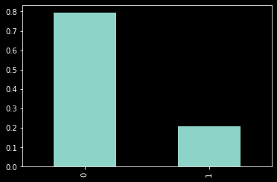
Univariate followed by Bivariate Analysis
P
H
A
S
E
2
150533
Target Variable
Total no. of Samples = 188166
37633

Slide 9
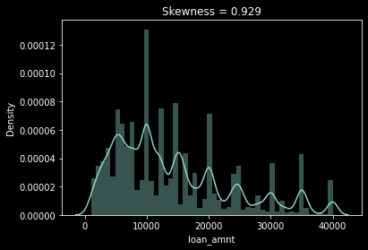
Loan_amnt as per the visual analysis we can say that loan amount is following a cyclic trend and can be a good predictor.
Univariate followed by Bivariate Analysis
P
H
A
S
E
2

Slide 10
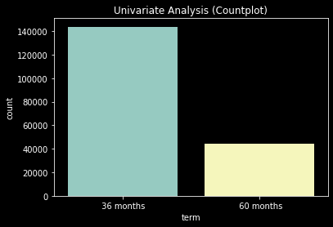
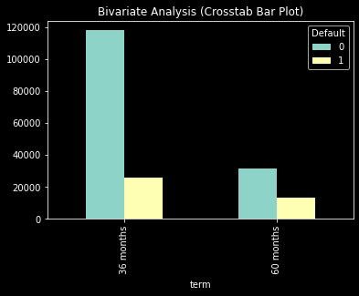
Term The probability of a person being defaulter is comparatively higher for the people opting for loan of 60 months duration than that of people opting for 36 months.
Univariate followed by Bivariate Analysis
P
H
A
S
E
2

Slide 11
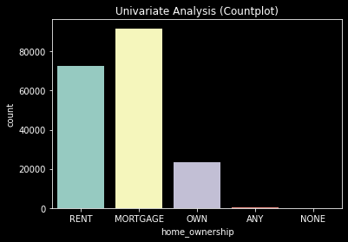
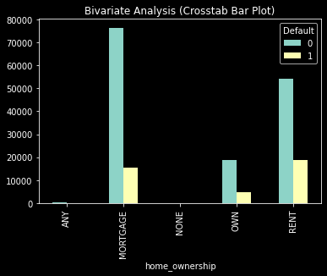
Home_ownership Most borrowers either own a home with a mortgage or rent their home. A smaller proportion of borrowers own their home outright (12.5%) or have some other form of home ownership (.11%). Borrowers who rent (25.7%) their home have a higher proportion of Default loans compared to borrowers who own their home with a mortgage (16.8%), though home_wonership is not the only feature on which Default is depend on.
Univariate followed by Bivariate Analysis
P
H
A
S
E
2

Slide 12
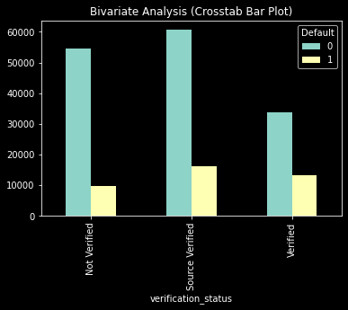
Univariate followed by Bivariate Analysis
P
H
A
S
E
2
Inferences: verification_status
Univariate Analysis:
There 3 catagories: Source Verified, Not Verified and Verified.
Majority of the income of the borrowers are Source verified (40.7%).
Bivariate Analysis:
Proportion of the Defaulters is minimum in the Not-Verified category followed by Source-Verified and Verified.
This trend is in contrast with the norm, because Verified income sources are more reliable.

Slide 13
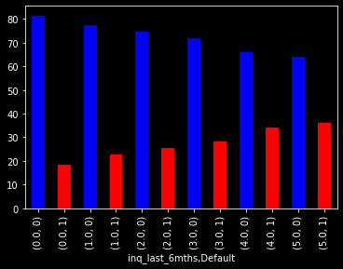
Univariate followed by Bivariate Analysis
P
H
A
S
E
2
Inferences: inq_last_6mnths
Business Understanding:
A higher value for inq_last_6mths may indicate that the borrower has been actively seeking credit, which could be an indication of increased credit risk.
On the other hand, a lower value for inq_last_6mths may indicate that the borrower has not been actively seeking credit, which could be an indication of lower credit risk
Bivariate Analysis:
This suggests that as Inquries in the last 6 months increases, the possibility of loan default increases. Though it is not the only factor on which the Default status of the individual depend on.

Slide 14
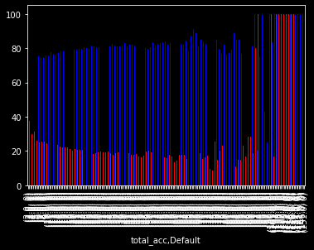
Univariate followed by Bivariate Analysis
P
H
A
S
E
2
Inferences: total_acc
From the plot, we can infer that people having a greater number of accounts are more likely to payback the loan and not default. Though this is not the only factor on which the Default status of the individual depend on.
Statistical Tests:
By doing Two Sample T Test and ANOVA: 'total_acc' is an important feature.

Slide 15
Treating Missing Values
P
H
A
S
E
3
Simple Imputation
KNN Imputer
We have simple imputation i.e., median for numerical feature and mode for Categorical features.
The columns that are imputed with simple imputation are:
pet tl nvr dig, avg cur bal,
all util, revol util, be open to buy, percent _bc gt 75, be util, mo sin old il acct,
emp_length, emp title
Since il_util has approximately 13% missing values and we did not get any relevant feature to fill the missing values so we are using KNN imputer for the same, as for 10% - 15% missing values KNN imputer works best.
Number of Neighbours is kept as 5, which is the default value.

Slide 16
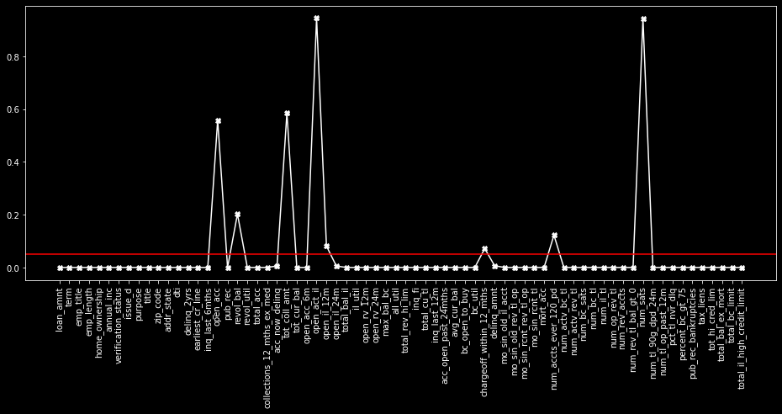
Statistical Analysis
P
H
A
S
E
4

Slide 17
Statistical Analysis
P
H
A
S
E
4
The RED horizontal line is representing P-Value at 5% Significance level.
The number of markers above the line are representing the features which are not significant for the prediction of target statistically.
Whereas, the number of markers below the loan are representing the features which are significant for the prediction of target statistically.

Slide 18
Significant Features
loan_amnt | addr_state | total_bal_il | bc_util | num_rev_accts
term | dti | il_util | delinq_amnt | num_rev_tl_bal_gt_0
emp_title | delinq_2yrs | open_rv_12m | mo_sin_old_il_acct | num_tl_90g_dpd_24m
emp_length | earliest_cr_line | open_rv_24m | mo_sin_old_rev_tl_op | num_tl_op_past_12m
home_ownership | inq_last_6mths | max_bal_bc | mo_sin_rcnt_rev_tl_op | pct_tl_nvr_dlq
annual_inc | pub_rec | all_util | mo_sin_rcnt_tl | percent_bc_gt_75
verification_status | revol_util | total_rev_hi_lim | mort_acc | pub_rec_bankruptcies
issue_d | total_acc | inq_fi | num_actv_bc_tl | tax_liens
purpose | collections_12_mths_ex_med | total_cu_tl | num_actv_rev_tl | tot_hi_cred_lim
title | acc_now_delinq | inq_last_12m | num_bc_sats | total_bal_ex_mort
zip_code | tot_cur_bal | acc_open_past_24mths | num_bc_tl | total_bc_limit
addr_state | open_acc_6m | avg_cur_bal | num_il_tl | total_il_high_credit_limit
dti | open_il_24m | bc_open_to_buy | num_op_rev_tl

Slide 19
Data Pre-Processing (Scaling & Encoding)
P
H
A
S
E
5
Splitting the data into train and test sets for validation
Doing target encoding on all the categorical features and standardizing the numerical columns for pre-processing.
Since our data is highly imbalanced with only 20 percent of the values corresponding to people who tend to default.
So we will use over sampling technique to balance the proportions of defaulters and non defaulters.
Since Statistical models only generate slope and not intercepts so we are adding a constant column so that the model is able to generate intercept.

Slide 20
03
Modelling
Statistical Model
Inferences from 1st model
For fitting the base model, logit model is fitted as in this model we can generate summary so it is easier to interpret.
Pseudo R Square value is 0.32
Log Likelihood : -1.1220e+05
LLN: -1.6546e+05
It is a significant model.
According to Yoden’s Index
Threshold = 0.34

Slide 21
Model Evaluation basis metrics
Train | Test | After Removing Insignificant Features | After readjusting the threshold level to 0.34
Accuracy = 78.5% | Accuracy = 68.89% | Accuracy = 68.74% | Accuracy = 68.93%
Precision = 78.6% | Precision = 33.8% | Precision = 34% | Precision = 30%
Recall = 78.2% | Recall = 52.4% | Recall = 52% | Recall = 72%
F1_Score = 0.784 | F1_Score = 0.41 | F1_Score = 0.41 | F1_Score = 0.42
Model is underfitting and cannot be improved further.

Slide 22
Phase -2 Feature Engineering & Model Building
Period:
2013-2018
$
XXXXXXXXX
DOLLARS
Group 3
Presented By

Slide 23
04
Feature Engineering Extracting new features from existing features
Features | Name of Features | Data Dictionary of new features
Feature 1 | fico_avg_score | Fico high and fico low scores of each applicant was provided in the dataset. The average of it was taken and the field was named fico_avg_score. While making predictions, Fico Score is taken as input.
Feature 2 | numb_col_val | It is the combination of all the features related to the number of accounts of an individual in different categories.
Feature 3 | income_to_loan_ratio | This is the ratio between the loan amount issued and the annual income of the applicant. [income_to_loan_ratio: annual_inc/ loan_amount ]
Feature 4 | credit_line_ratio | This is the ratio between open credit lines in the borrower’s file and the total number of credit lines ever opened in the borrower’s file. [credit_line_ratio = open_acc / total_acc]
Feature 5 | disposable_inc | It is an approximate income left with the individual after the person paid the principle amount of the loan for that year.
Feature 6 | addr_state | Dividing the states on the basis of their geographic location.

Slide 24
Scaling & Encoding
Using log transformation on loan_amnt to reduce the impact of extreme values and improve its distribution.
P
R
E
P
R
O
C
E
S
S
I
N
G
By applying min-max scaling, we can transform the features to a similar scale and range. This can help the model to learn from all the features equally, and prevent the larger-scale features from dominating the model. This can lead to better model performance and generalization.
Encoding the categorical features: Factorize encoding can be useful because many of the features are categorical variables that have no inherent order or numerical meaning.

Slide 25
CHECKING THE IMBALANCE IN THE DATA
AdaSyn is a resampling technique that can be used to address class imbalance in datasets, particularly in binary classification problems where the number of examples in one class (e.g., defaulters) is much smaller than the other class (e.g., non-defaulters).
D
A
T
A
I
M
B
A
L
A
N
C
E

Slide 26
Logistic regression is a binary classification method that uses a logistic function to estimate the probability of a binary outcome variable based on one or more predictor variables
M
O
D
E
L
S
E
L
E
C
T
I
O
N
Random Forest Classifier is a type of ensemble learning method in which multiple decision trees are constructed and combined to improve the accuracy and robustness of the classification model. Each tree in the random forest is trained on a randomly selected subset of features and a randomly sampled subset of the training data.
Decision tree classifier is a type of supervised machine learning algorithm that performs classification by recursively splitting the dataset into smaller and smaller subsets based on the feature values. The algorithm creates a tree-like model of decisions and their possible consequences.
CatBoost is a machine learning algorithm that is commonly used for classification tasks. It is an ensemble learning method that combines several decision trees to create a strong classifier.

Slide 27
Ridge Classifier is a type of linear model that performs binary classification by finding the linear combination of features that best separates the positive and negative classes. The Ridge Classifier adds an L2 regularization term to the objective function, which helps to prevent overfitting and improve the model's generalization ability.
M
O
D
E
L
S
E
L
E
C
T
I
O
N
Naive Bayes is a type of probabilistic machine learning algorithm that is commonly used for classification tasks. It is based on Bayes' theorem, which describes the probability of an event based on prior knowledge of related events.
AdaBoost, short for Adaptive Boosting, is a machine learning algorithm that is commonly used for classification tasks. It is an ensemble learning method that combines several weak learners (e.g., decision trees, logistic regression) to create a strong classifier.
Gradient Boosting is a machine learning algorithm that is commonly used for regression and classification tasks. It is an ensemble learning method that combines several weak learners (e.g., decision trees, linear models) to create a strong model.

Slide 28
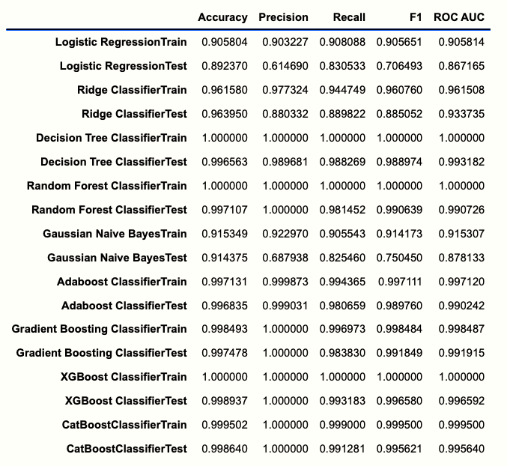
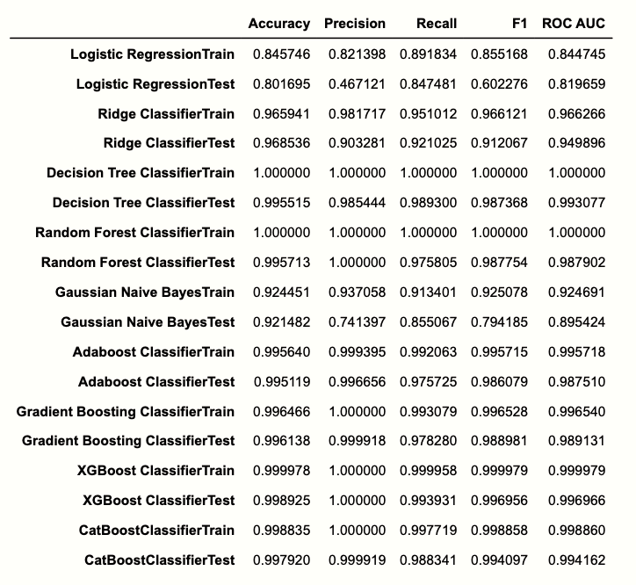
Year Wise Model Matrix
MODEL MATRIX OF YEAR- 2013
MODEL MATRIX OF YEAR- 2014
M
O
D
E
L
E
V
A
L
U
A
T
I
O
N

Slide 29
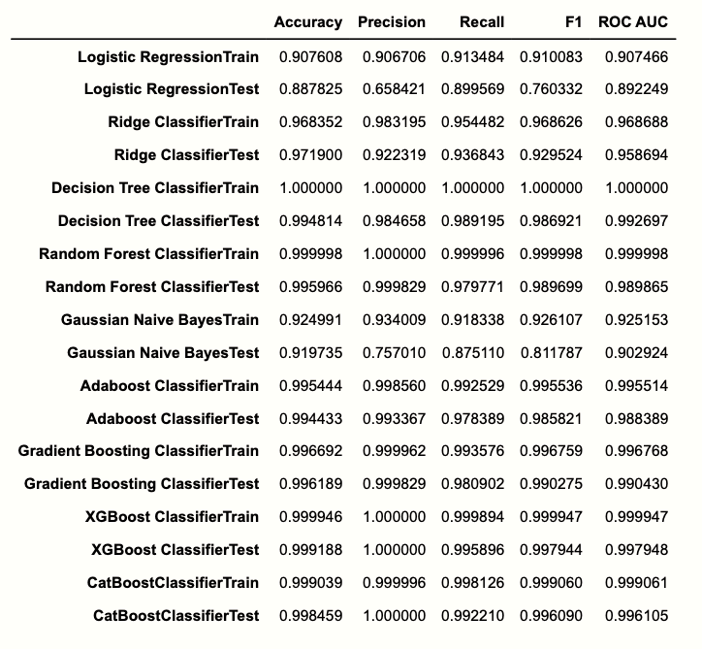
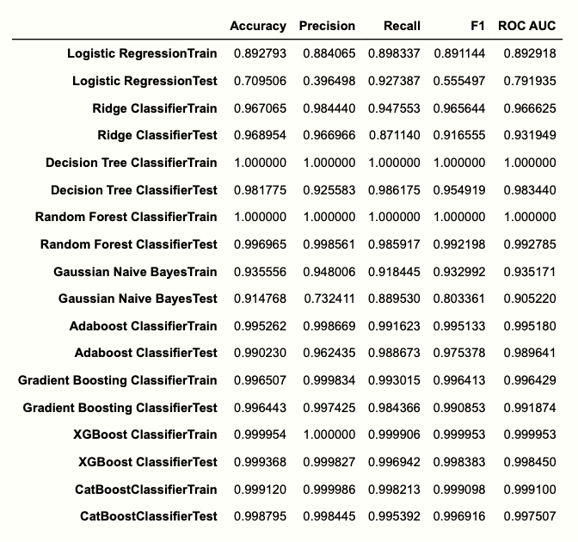
Year Wise Model Matrix
MODEL MATRIX OF YEAR- 2015
MODEL MATRIX OF YEAR- 2016
M
O
D
E
L
E
V
A
L
U
A
T
I
O
N

Slide 30
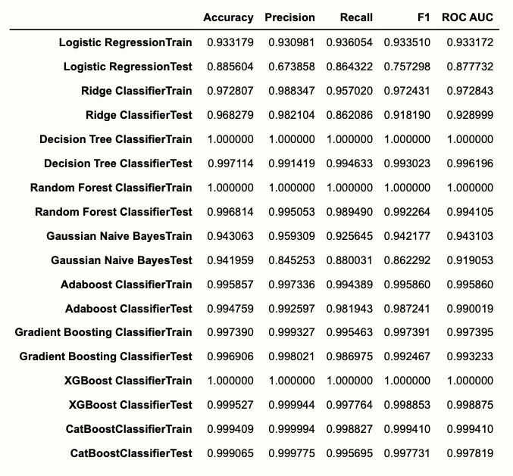
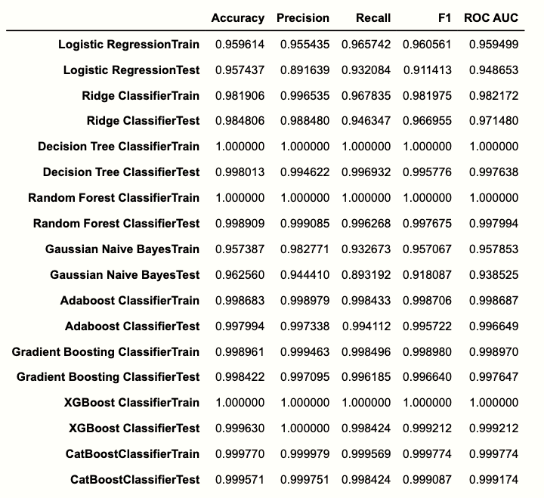
Year Wise Model Matrix
MODEL MATRIX OF YEAR- 2017
MODEL MATRIX OF YEAR- 2018
M
O
D
E
L
E
V
A
L
U
A
T
I
O
N

Slide 31
We have applied Hyper-parameter tunning for DT, RF and Ridge Classifier.
M
O
D
E
L
T
U
N
I
N
G
For Decision Tree:
Max Depth : [2,3,4,5,6]
Criterion: ['Gini', 'Entropy]
For Random Forest:
Max Depth : [2,3,4,5,6]
Criterion: ['Gini', 'Entropy]
N_Estimators : [100, 200, 300, 400, 500]
For Ridge Classifier:
Lambda: L2 Penalty : 0.1 to 1
Out of all the models, Ridge Classifier gives the best results for all the Years..

Slide 32
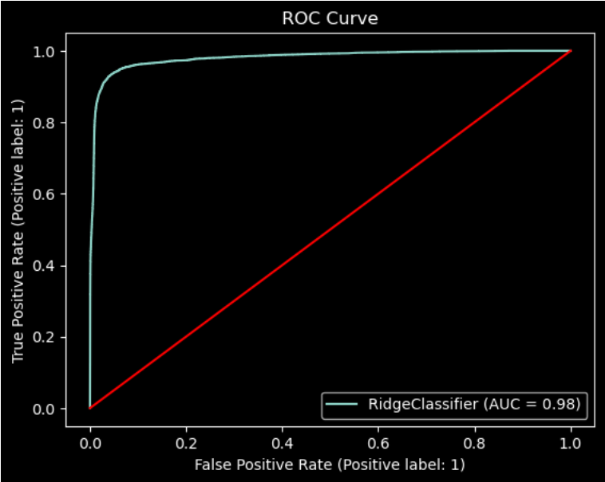
Year Wise Model Deployment
M
O
D
E
L
D
E
P
L
O
Y
M
E
N
T
RIDGE CLASSIFIER DEPLOYMENT OF YEAR- 2013 | MODEL DEPLOYMENT OF YEAR- 2013
 | Train Metrics | Test Metrics
Confusion Matrix | [[77916 1733 [4363 74604]] | [[33378 758 [695 5613]]
Accuracy | 0.961568 | 0.964074
Precision | 0.977298 | 0.881023
Recall | 0.944749 | 0.889822
F1 Score | 0.960748 | 0.885401
ROC-AUC Curve | 0.961496 | 0.933809

Slide 33
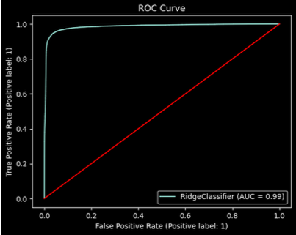
Year Wise Model Deployment
RIDGE CLASSIFIER DEPLOYMENT OF YEAR- 2014 | MODEL DEPLOYMENT OF YEAR- 2013
 | Train Metrics | Test Metrics
Confusion Matrix | [[133205 2504 [6940 134667]] | [[56934 1227 [988 11535]]
Accuracy | 0.965945 | 0.968663
Precision | 0.981745 | 0.903855
Recall | 0.950991 | 0.921105
F1 Score | 0.966124 | 0.912399
ROC-AUC Curve | 0.966270 | 0.950004
M
O
D
E
L
D
E
P
L
O
Y
M
E
N
T

Slide 34
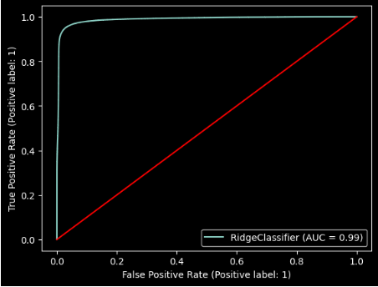
Year Wise Model Deployment
M
O
D
E
L
D
E
P
L
O
Y
M
E
N
T
RIDGE CLASSIFIER DEPLOYMENT OF YEAR- 2015 | MODEL DEPLOYMENT OF YEAR- 2013
 | Train Metrics | Test Metrics
Confusion Matrix | [[222093 3857 [10771 226145]] | [[222093 3857 [10771 226145]]
Accuracy | 0.9683969010469553 | 0.971983133548168
Precision | 0.9832305806036469 | 0.9226644669003918
Recall | 0.9545366290161914 | 0.9368848682832852
F1 Score | 0.9686711585331899 | 0.9587611172760141
ROC-AUC Curve | 0.9686711585331899 | 0.9297202942521092

Slide 35
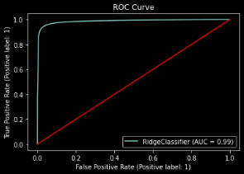
Year Wise Model Deployment
M
O
D
E
L
D
E
P
L
O
Y
M
E
N
T
RIDGE CLASSIFIER DEPLOYMENT OF YEAR- 2016 | MODEL DEPLOYMENT OF YEAR- 2013
 | Train Metrics | Test Metrics
Confusion Matrix | [[219438 3184 [11150 201444]] | [[94719 691 [2992 20227]]
Accuracy | 0.967065 | 0.968954
Precision | 0.984440 | 0.966966
Recall | 0.947553 | 0.871140
F1 Score | 0.965644 | 0.916555
ROC-AUC Curve | 0.966625 | 0.931949

Slide 36
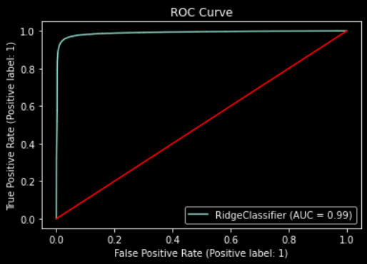
Year Wise Model Deployment
M
O
D
E
L
D
E
P
L
O
Y
M
E
N
T
RIDGE CLASSIFIER DEPLOYMENT OF YEAR- 2017 | MODEL DEPLOYMENT OF YEAR- 2013
 | Train Metrics | Test Metrics
Confusion Matrix | [[158576 1818 [6925 154195]] | [[68460 281 [2467 15421]]
Accuracy | 0.972807 | 0.968279
Precision | 0.988347 | 0.982104
Recall | 0.957020 | 0.862086
F1 Score | 0.972431 | 0.918190
ROC-AUC Curve | 0.972843 | 0.928999

Slide 37
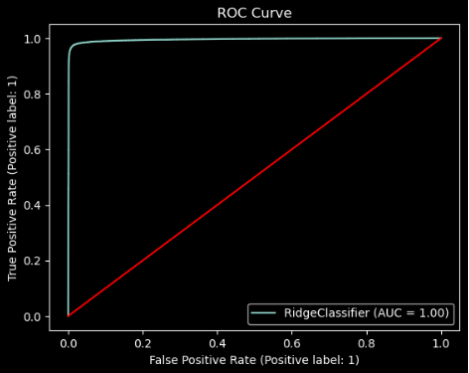
Year Wise Model Deployment
M
O
D
E
L
D
E
P
L
O
Y
M
E
N
T
RIDGE CLASSIFIER DEPLOYMENT OF YEAR- 2018 | MODEL DEPLOYMENT OF YEAR- 2013
 | Train Metrics | Test Metrics
Confusion Matrix | [[91325 321 [3047 92056]] | [[39142 135 [646 11413]]
Accuracy | 0.981965 | 0.984787
Precision | 0.996525 | 0.988310
Recall | 0.967961 | 0.946430
F1 Score | 0.982035 | 0.966917
ROC-AUC Curve | 0.982229 | 0.971496

Slide 38
Based on the performance metrics you provided, it appears that the Ridge Classifier is performing very well on both the training and test data. The high precision, recall, and F1 scores on the training data suggest that the model is able to accurately identify both positive and negative cases with high confidence. The similarly high precision, recall, and F1 scores on the test data suggest that the model is also able to generalize well to new data. The F1 score, which is a harmonic mean of precision and recall, is a good measure of the overall performance of the model. The F1 score of 96% for the training data and 92% for the test data indicates that the model is performing very well overall, with high accuracy and relatively low error rates. It is worth noting that Ridge Classifier is a linear classifier that uses L2 regularization to prevent overfitting. It works well with high-dimensional and sparse data, and it can be faster and more scalable than some other algorithms such as logistic regression or SVMs. However, it may not perform as well on datasets with complex or nonlinear relationships between the features and the target variable. Depending on the specific characteristics of the dataset, other algorithms such as decision trees, random forests, or neural networks may be able to achieve higher accuracy.
C
O
N
C
L
U
S
I
O
N

Slide 39
05
References
Research Papers
Official Website
https://digitalcommons.bard.edu/cgi/viewcontent.cgi?article=1299&context=senproj_s2019
https://cs229.stanford.edu/proj2018/report/69.pdf
https://home.csulb.edu/~jchang9/files/jonathan_guzman_honors_thesis.pdf
https://medium.com/swlh/lending-club-data-web-app-ada56ff64cee
https://www.lendingclub.com/
Kaggle Link & Video Reference Link
https://www.kaggle.com/datasets/ethon0426/lending-club-20072020q1
https://www.youtube.com/watch?v=bScpRt1C8V0&t=822s

Slide 40
Thank You!
Period:
2013-2018
$
XXXXXXXXX
DOLLARS
Group 3
Presented By

